Slide 1







Travolla
“Making Travel More Accessible
To More People”

Slide 2
I Problem & Solution

Slide 3
Problem
The preparation of a trip is very time-consuming
People are too busy
People are too stressed
People are on a budget
People don’t experience a meaningful interaction with locals
People are unaware of usual traffic in the area(locations / activities)
Have not found any app that generates the timetable for a trip’
People might miss out on the most popular activities/restaurants and events if they are unfamiliar with their destination

Slide 4
Solution
An Optimised journey planner that generates an efficient itinerary for a traveller based on their preferences.
A heat map allows travellers and guides to visualise which attractions are busy in realtime.
The traveller-guide matching service pairs travellers with locals from the city in which they are travelling

Slide 5
II Product & Services

Slide 6
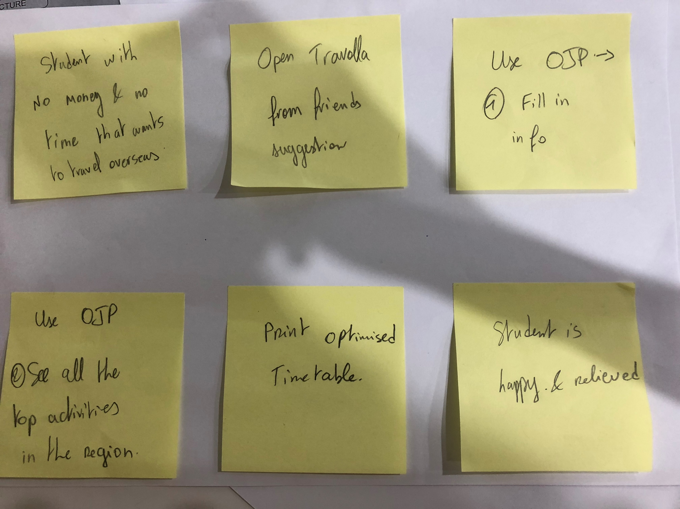
User Test Flow 1 – Optimised Journey Planner

Slide 7
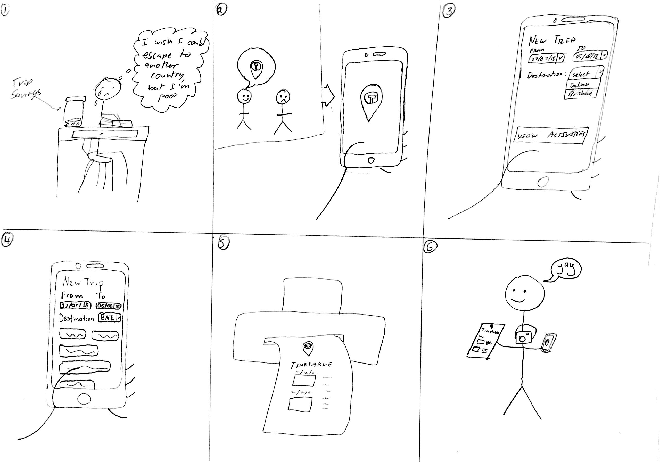
Storyboard 1 – Optimised Journey Planner

Slide 8
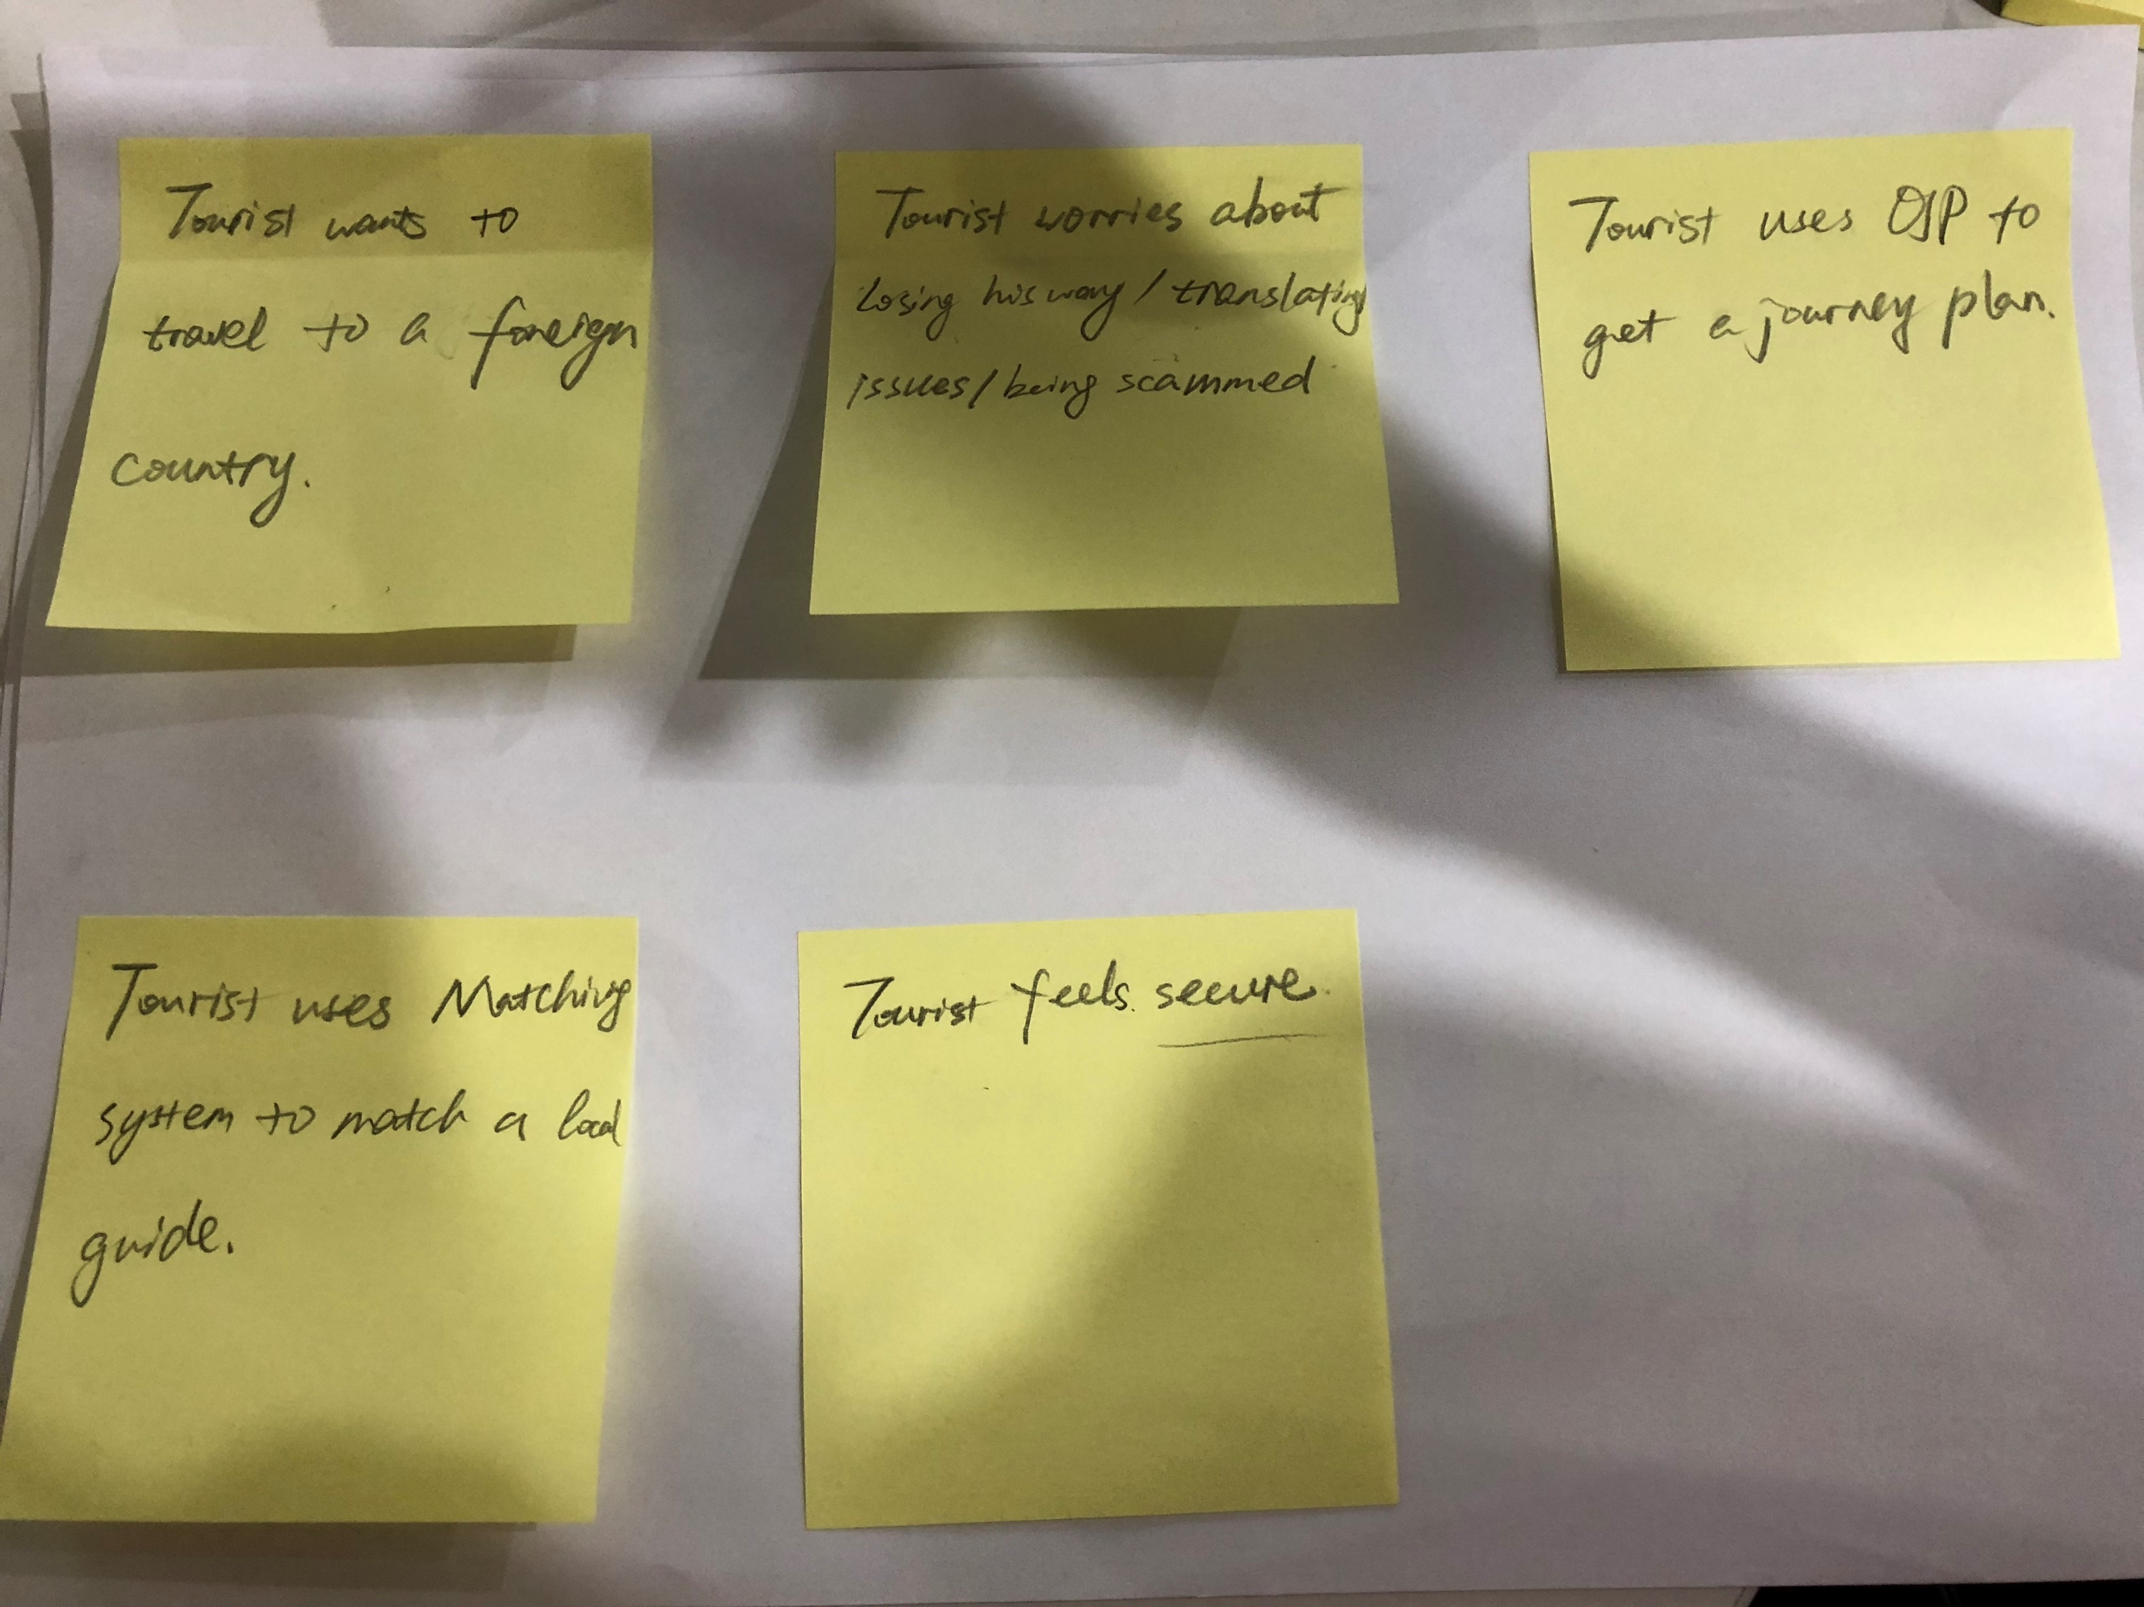
User Test Flow 2 – Local Guide/Tourist Match

Slide 9
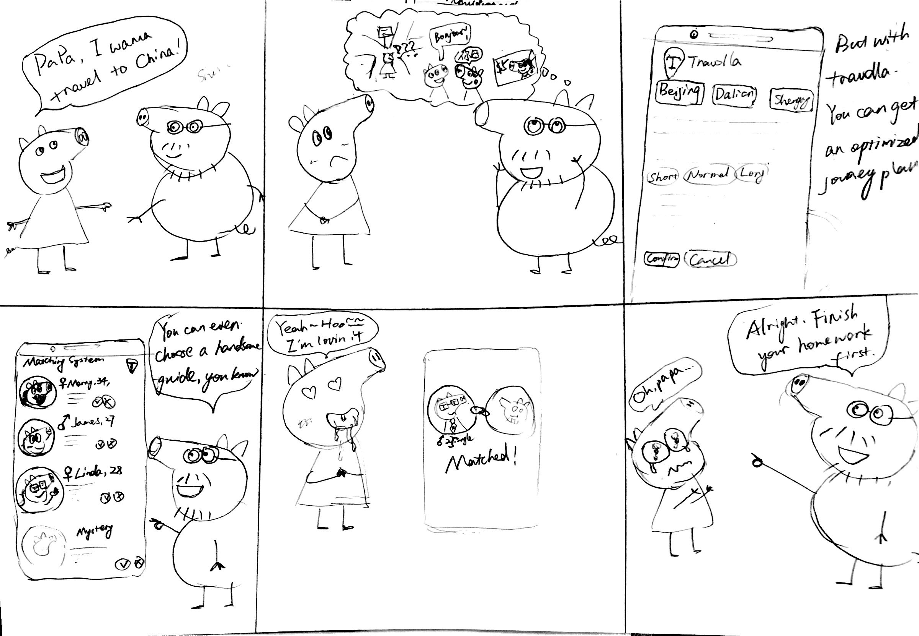
Storyboard 2 – Local Guide/Tourist Match

Slide 10
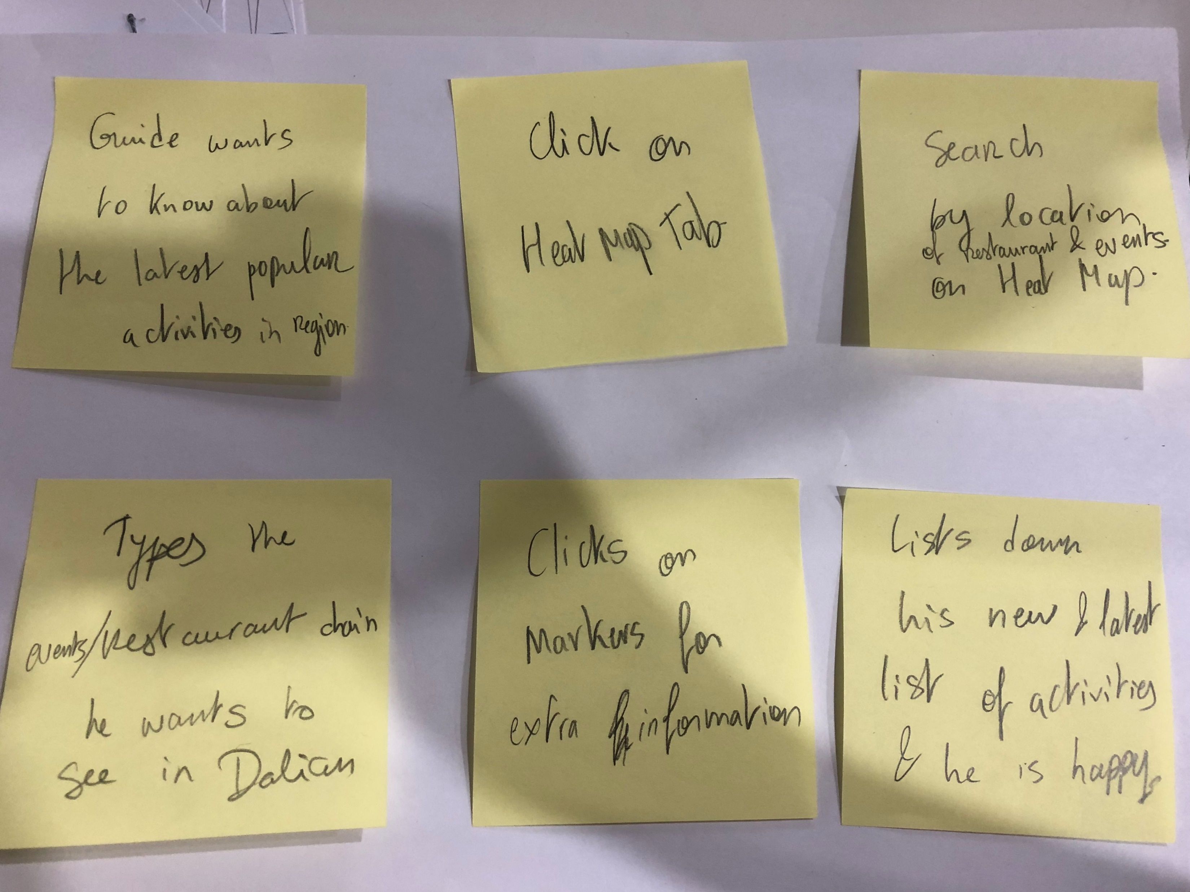
User Test Flow 3 – Heat Map (Shows popular places and spots)

Slide 11
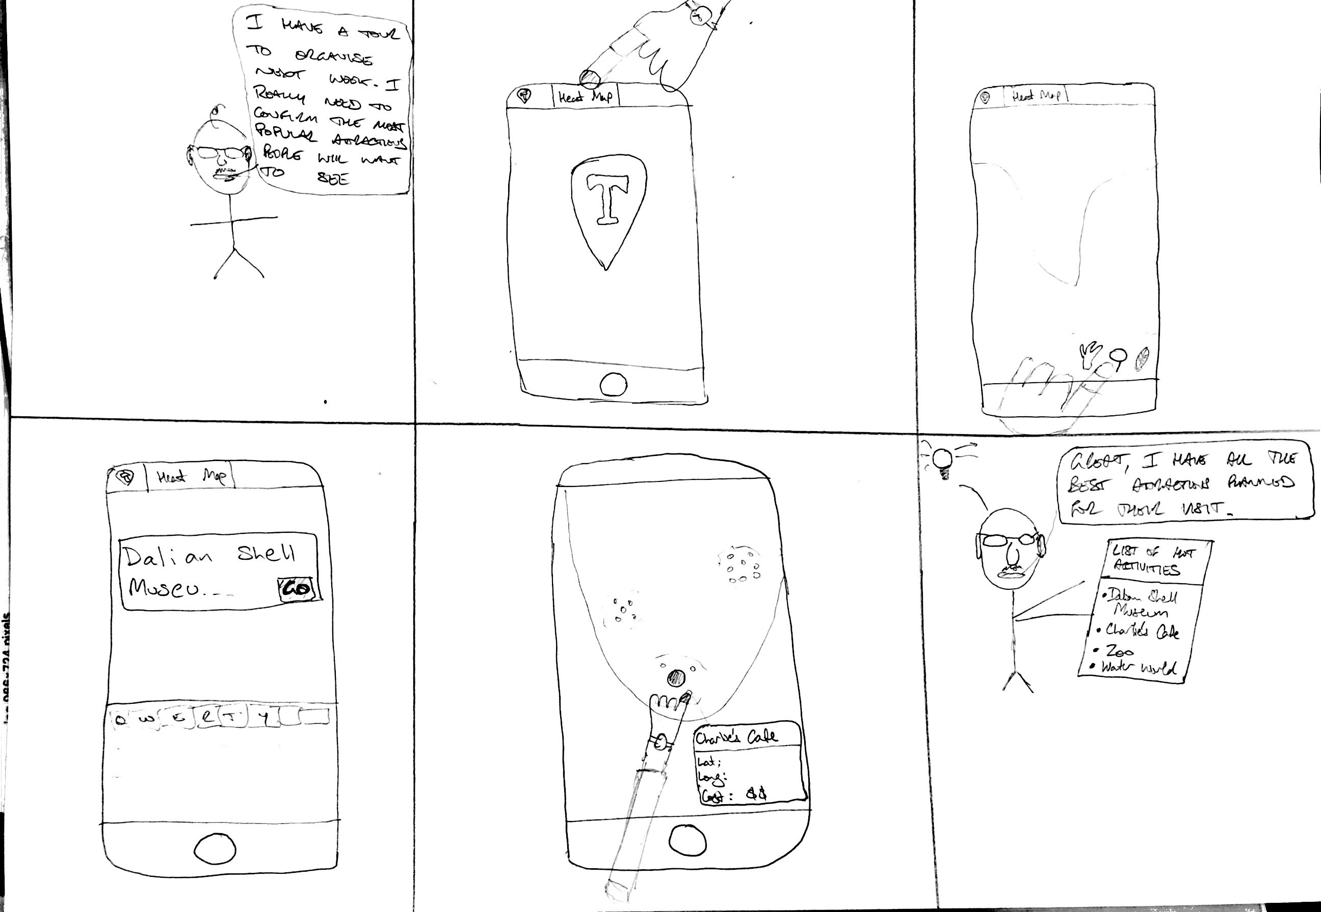
Storyboard 3 – Heat Map (Shows popular places and spots)

Slide 12
III Business Model

Slide 13
INFRASTRUCTURE
OFFER
CUSTOMER
3.1) CORE CAPABILITIES
Establishing relationship with the Venue Operators and Advertisers
Designing and Developing Online Systems
Personal Guides
Maintaining Online Systems
3.3) KEY PARTNERS
Advertisers, Restaurants, Attraction Operators
Tourist Board and Chambers of Commerce
Travel Agents
Apple Store / Play Store
Local Guides
Social Media Influencers
1) VALUE PROPOSITION
Saving Time
Enhancing Accessibility
Assisting to bridge cultural and language divides
More personal experience
Targetted Geolocational data + Information about customer preferences
Growth of customer base
2.1) TARGET CUSTOMER
Audience :
Adults (18+) who may travel (tourist or new tourists)
Adults (18+) who may guide (guides or new guides)
Disabled (colour blind, mobility)
Elderly
Advertisers
Attraction owners
3.2) VALUE CONFIGURATION
Sales Team
Talented Designers and Programmers
Local Guides
Server and Network Infrastructure
2.2) DISTRIBUTION CHANNELS
Travolla Website and App
Top activity list
SEOs
Alerts
2.3) CUSTOMER RELATIONSHIP
Personalised Services based on customer preferences
24/7 Customer service
Reviews and Ratings (Building Trust)
Accessibility information
Increased sales and bookings
FINANCE
4.1) REVENUE STREAMS
E-payment of Bookings / Commission
Premium Ranking Space
Pop alerts
4.2) COST STRUCTURE
Salaries
Capital Expenditures
Advertising
Legal Fees
Taxes
Hosting Fees

Slide 14
IV Market Size & Share

Slide 15
Market Size & Share
Overall Tourism Industry is worth: 5 Trillion US Dollars
AirBnB is worth : 31 Billion US Dollars
→ AirBnb is 0.62% of the total industry value
→ Travolla is worth 1% of AirBnb total value = 0.0062% of Total industry value

Slide 16
V Industry Analysis

Slide 17
Tourism Industry Analysis
Concentration
Entry & Exit Barriers
Product Differentiation
Information
There are a large number of firms each with a small market share
Entry:
Verification from foreign governments
o Pressure from other firms with similar service
o Need volume to make money – critical mass
o Low startup costs
o Low switching costs
Usually related to hotel booking, flight booking
Results in high degree of information mobility and availability
Exit:
o Very low – slim software startup
o No fixed costs

Slide 18
Tourism Industry Analysis
Perfect Competition
Oligopoly
Duopoly
Monopoly
Concentration
Low concentration
Entry & Exit Barriers
Low Barriers
Product Differentiation
Moderate Potential for Product Differentiation
Information
High availability of Information

Slide 19
Porter’s Five Forces
Threat of New Entrants
Industry Rivalry
Bargaining Power of Suppliers
- Reasonably low barriers to entry
- Low sunk costs for services similar to Travolla
- Economies of scale are easy to harness for services similar to Travolla
- High government regulation in many countries
- Sustainable competitive advantage through innovation
- High advertising expense
- Low degree of concentration
- Large number of suppliers with moderate product differentiation, large number of substitute inputs – Reduces bargaining power
- Price largely dictated by supplier – Increases bargaining power
Bargaining Power of Buyers
Threat of Substitute Products
- High dependency on existing channels of distribution – lowers bargaining power
- High degree of information – increases bargaining power
- Moderate degree of product differentiation – increases bargaining power
- High buyer propensity to substitute
- Low switching cost
- Difficult to substitute – have to use multiple services to emulate Travolla’s service

Slide 20
VI Competitors Analysis

Slide 21








Competition Analysis
Expensive
Matches tourists with local guides
Fixed program
900,000 Users
Matches tourists with local guides
Fixed program
Matches tourists with local guides
Flexible program
No online planning automation
Matches tourists with local guides
Fixed program
350,000 Users
Offline
Online
Matches tourists with professional guides
Fixed program – little opportunity for customisation
’Neighbourhood’ tool for planning activities
Large user base
Accommodation booking
Marketplace for local guides
Flexible program
No online planning automation
Matches tourists with local guides
Flexible program
8,675 Destinations
Cheap

Slide 22

Competitors Analysis
Leading Competitor
Who: Airbnb, Inc., 888 Brannan Street, 4th Floor, San Francisco, CA 94103, United States
Where: Targets global market
Product & Service: Short term accomodation - alternative provider / now also providing “experiences” & restaurant
Customers: predominantly recreational travellers
Partners: home owners, small accomodation providers (eg serviced apartment owners)
Prices: 3% commission
Promotion Channels: Online advertising (Facebook, Instagram),TV and print media, in flight magazines.
Distribution channel: online - via app and website, App Store, Google Playstore.
Organisational Structure: US domiciled corporation

Slide 23
Competitors Analysis
Travolla VS AirBnb
Advantages | Disadvantages
Hotel accomodation market is not highly competitive (probably best characterised as an oligopoly as in any location there are typically only a few significant hotels operating). AirBnB exploited this in targeting private rentals, creating the “sharing economy”. | Inconsistent quality and service of properties vs hotels.
First mover advantage / scale - AirBnB is well funded by VCs with considerable market capitalisation | People might not want to stay with strangers. Safety and Security issues.
Air BnB has a major competitive advantage in that, unlike Travolla and sites such as TripAdvisor, Air BnB did not require large amounts of local knowledge (content) to commence its core operations. Their data was wholly contributed by users wanting to rent out their apartments/spare rooms

Slide 24

Competitors Analysis
Niche Competitor
Who: WithLocals
Where:
Product & Service: Personal Tour Guide, Tips for trips, Local Activities
Customers: Locals (Adults) who would like to be tour guides & Tourists (Everyone) who would like to travel with a local.
Partners: Locals
Prices: 20% Commission
Promotion Channels: Videos
Distribution Channels: Facebook, YouTube, News
Platforms: Website, iOS, Android

Slide 25
Competitors Analysis
Travolla VS WithLocals
Advantages | Disadvantages
Unique traveling experience | Pre-defined plans
Lower price | Only available in some countries/areas
Pre-defined plans | Expensive for a short time / individual
Easy to use

Slide 26
Product Advantages
Travolla takes more complete approach to travel process:
Planning
Completely automated and flexible activity planning
Provides information on best activities
Provides information on best time and order to do activities
Visual approach to planning
Executing Plan
Match guides and tourists based on variety of factors
More personalised matching than other services
Travolla is a more inclusive platform
Specialised support for elderly and disabled
Can be tailored to travellers of all backgrounds/ages

Slide 27
Product Disadvantages
No linking with social networks
Potential safety issues
Not many payment options
Unable to fully control prices of activities
Difficult to reach older demographic

Slide 28
VII Team Milestones

Slide 29
Team Milestones
Iteration 1
Project Concept Development
Business Plan Development
Prototype Development
Done
Iteration 2
Investor/Legal Meetings
Further Development of Key Features
Expansion to More Destinations
Iteration 3
Extend Company Partnerships
Execute Marketing Strategy
Extend Core Features to Accommodation
To Do
Long Term
Continuous Customer Support
Continuous Revenue (Sponsored Ads + Commission)
Continuous Maintenance

Slide 30
VIII Founder Team & Organisation Structures

Slide 31




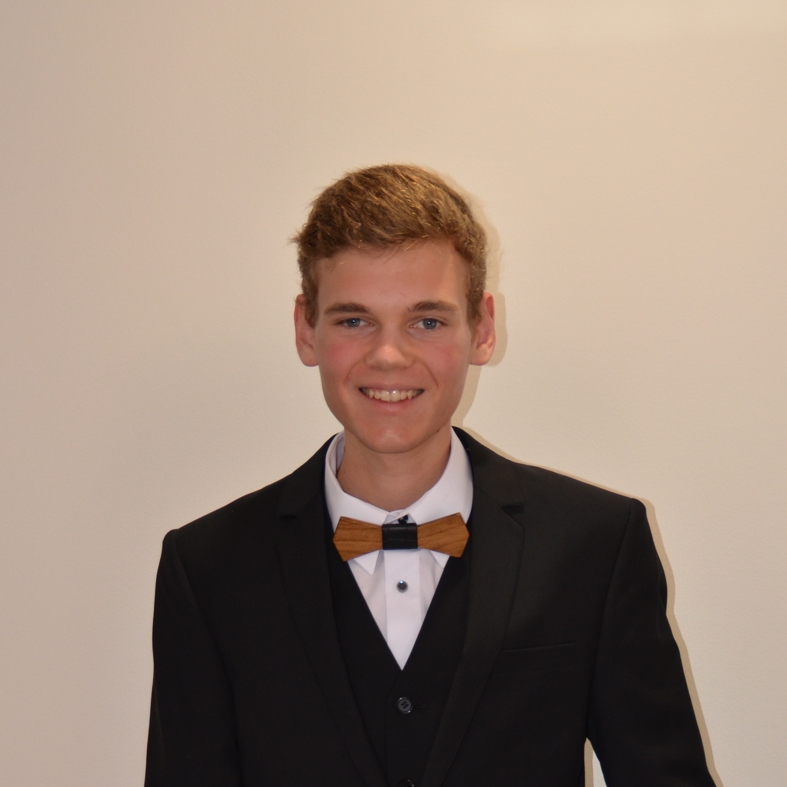

The innStation (Travolla) Team
Léa Laï Van
UI designer – 16.6%
Designer (UX/UI)
Front end
Jason Zhang
CEO – 16.6%
- Programmer
- Front end
Henry Burgess
Software Eng. – 16.6%
Programmer
Front end
Ada Rao
Database admin – 16.6%
Programmer
Database / Backend
Erik Brand
Project Manager – 16.6%
Programmer
Front / back end
Ed Sweeney
Biz dev/Network – 16.6%
Programmer
Database / Backend
Business planning

Slide 32
Advantages of the innStation (Travolla) team
Team advantages:
Diverse skills in design, programming, business
Extensive experience in software engineering
Multi-lingual (English & Chinese), unified team
Strong work ethic
Team building:
?????????

Slide 33
Corporate structure
Incorporated entity (company) based in:
a major technology centre
convenient to all participants
close to sources of venture capital
Shareholders’ equity ratio:
Currently 100% owned by team
Will be diluted by capital raising

Slide 34
COST
02
STAGE TWO
04
STAGE FOUR
01
STAGE ONE
03
STAGE THREE
Populate attractions
Seek local guides
Publish YouTube renews
Sponsored content / media releases
Pay vloggers to review
Continue growing users & guides
Continue saving
payments from sponsors
Continue advertising & seek partnerships
Scale up network
Continue growing attraction
Advertise tech sites, travel sites, travel blogs
Sell advertising to attraction owners, restaurants
Trovlla preferred endorsements
Incorporate company
Develop website
Deploy to cloud
Publish tot Apps Store

Slide 35
IX Financial Plan

Slide 36
Financial plan
Capital requirements:
Year | Stage / milestone | Capital req’d | AUD equiv | Raise by
0 - 0.5 | Stage one: create | ¥175,000 | $35,000 | Angel investment
0.5 – 1.0 | Stage two: launch | ¥500,000 | $100,000 | Venture Capital
1 - 4 | Stage three: growth | ¥6,000,000 | $1,200,000 | Venture Capital
4+ | Stage four: revenue | ¥0 | $0 | Profitable

Slide 37
Capital allocation (yr 1, Angel round)
Cost centre – stage one - two | Estimated cost (¥ / AUD equivalent)
General corporate | ¥51,000 | AU$10,200
Corporate lease (office at incubator) | ¥36,000 | AU$7,200
Developer salaries | ¥510,000 | AU$102,000
Marketing expenditure | ¥30,000 | AU$6,000
Network requirements (VPS rental) | ¥16,320 | AU$3,264
Total for angel round (year 1) | ¥643,320 | AU$128,664

Slide 38
Capital requirements – Angel round
Stage one - 3-6 mths | /mth | 6 months | AUD equivalent
Corporate costs | 3500 | 21000 | 4200
Corporate lease (1 office, incubator) | 3000 | 18000 | 3600
Residential lease (3 bedroom) | 5000 | 30000 | 6000
Virtual private server (VPS) rental | 160 | 960 | 192
Salaries | 15000 | 90000 | 18000
Marketing | 0 | 0 | 0
 |  |  | 0
Sub-total ( 6 months) | 26660 | 159960 | 31992
 |  |  | 0
 |  |  | 0
Stage two - 6 - 12 mths | /mth |  | 0
Corporate costs | 5000 | 30000 | 6000
Corporate lease (1 office, incubator) | 3000 | 18000 | 3600
Residential lease (3 bedroom) | 5000 | 30000 | 6000
Duplicated VPS hosting (production) | 2560 | 15360 | 3072
Programming salaries (subsistence) | 60000 | 360000 | 72000
Marketing | 5000 | 30000 | 6000
Sub-total ( 6 months) |  | 483360 | 96672
Sub-total (first full year) | 80560 | 643320 | 128664

Slide 39
Capital requirements – VC round

Slide 40
X Teamwork & Management

Slide 41
Week 1 Summary
Goals
Outcomes
Determine product industry
Use mind mapping to select 3 core functionalities for the product
The tourism industry was selected
Three core functionalities were selected:
Optimised Journey Planner
Heatmap
Local / Tourist matching service

Slide 42
Week 2 Summary
Goals
Outcomes
Decide whether product will be an app or a website.
Begin development of all 3 core functionalities
Begin and finish documentation
Product will be a website
Development underway for 2 out of 3 core functionalities (completed first iteration of Heatmap)
Initial documentation complete

Slide 43
Week 3 Summary
Goals
Outcomes
Finish all 3 core functionalities
Update any finished functionalities further if time allows
Fully integrate system with database
All 3 core functionalities completed
Refinements were made to Optimised Journey Planner and Heatmap
System is mostly integrated with the database

Slide 44
XI Task History

Slide 45
Week 2 Task Completion
Monday 2nd July | Tuesday 3rd July | Wednesday 4th July | Thursday 5th July | Friday 6th July
Determined project format (website) |  | Began development of OJP. | Began development of Heatmap | Began development of landing page.
 |  | Began formulation of the database schema. |  | Finished first version of Heatmap
 |  |  |  | Added documentation.

Slide 46
Week 3 Task Completion
Monday 9th July | Tuesday 10th July | Wednesday 11th July | Thursday 12th July | Friday 13th July
Updates to documentation. | Further integration of database systems | Created global header and footer | Finished first iteration of product | Began development of landing page.
Updates to user account system. | Fixes to Optimised Journey Planner and Heatmap | Began development of local / tourist matching system | Prepared technical demonstration | Finished first version of Heatmap
Finished first iteration of Optimised Journey Planner |  |  |  | Added documentation.

Slide 47
Week 4 Task Completion
Monday 16th July | Tuesday 17th July | Wednesday 18th July | Thursday 19th July | Friday 20th July
Began formulation of business plan | Finished business plan | Began the final presentation

